Slide 1


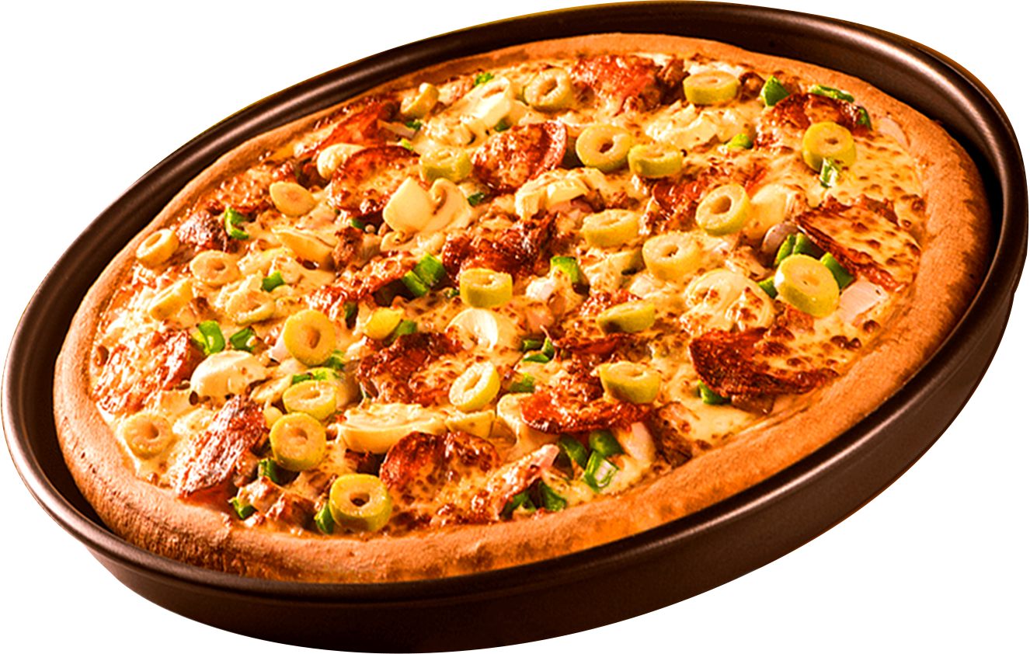


PIZZA SALES
ANALYSIS
Life is short, eat the pizza!

Slide 2
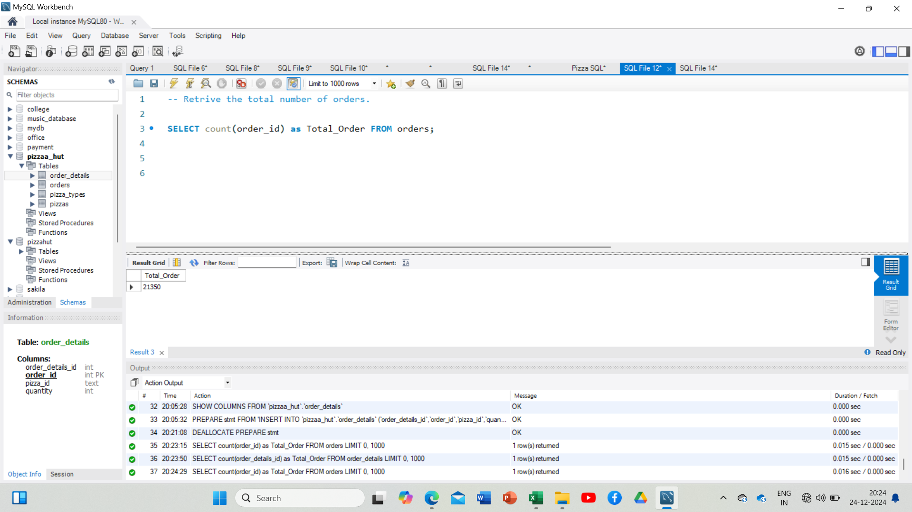
RETRIEVE THE TOTAL NUMBER OF
ORDERS PLACED.

Slide 3
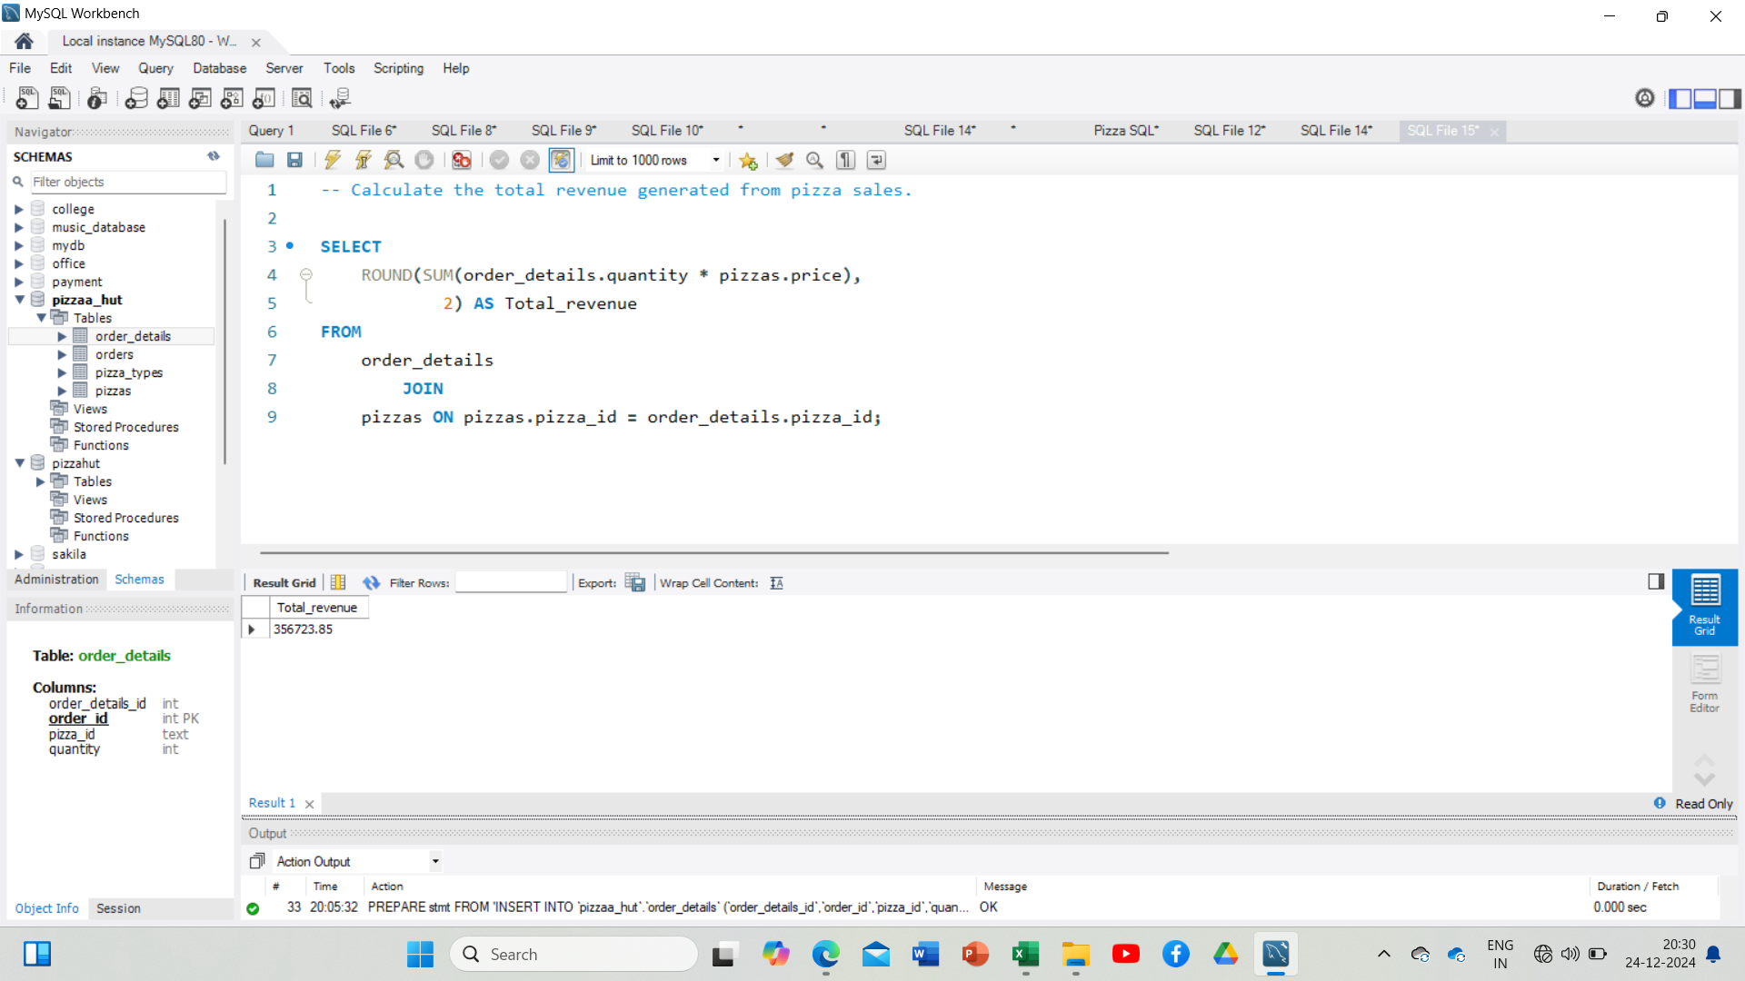
CALCULATE THE TOTAL REVENUE
GENERATED FROM PIZZA SALES.

Slide 4
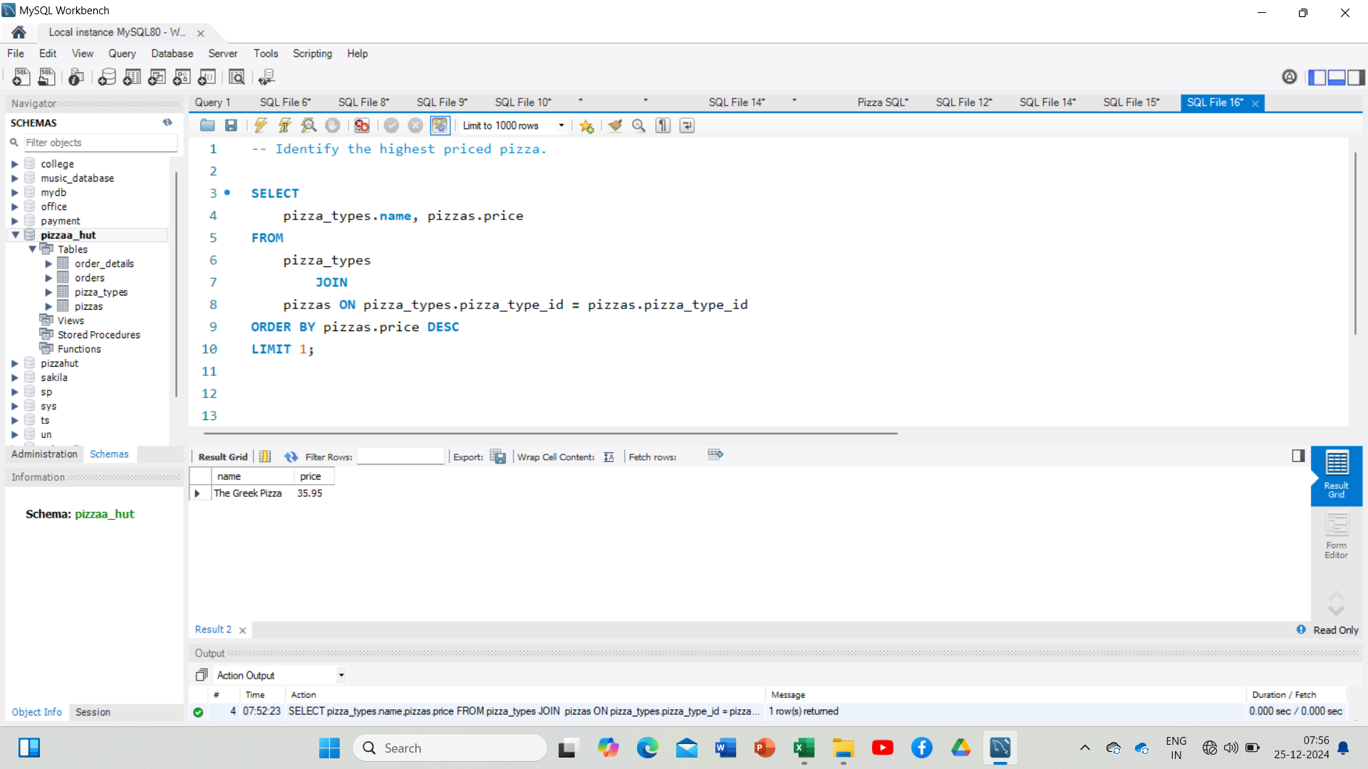
IDENTIFY THE HIGHEST-PRICE PIZZA.

Slide 5
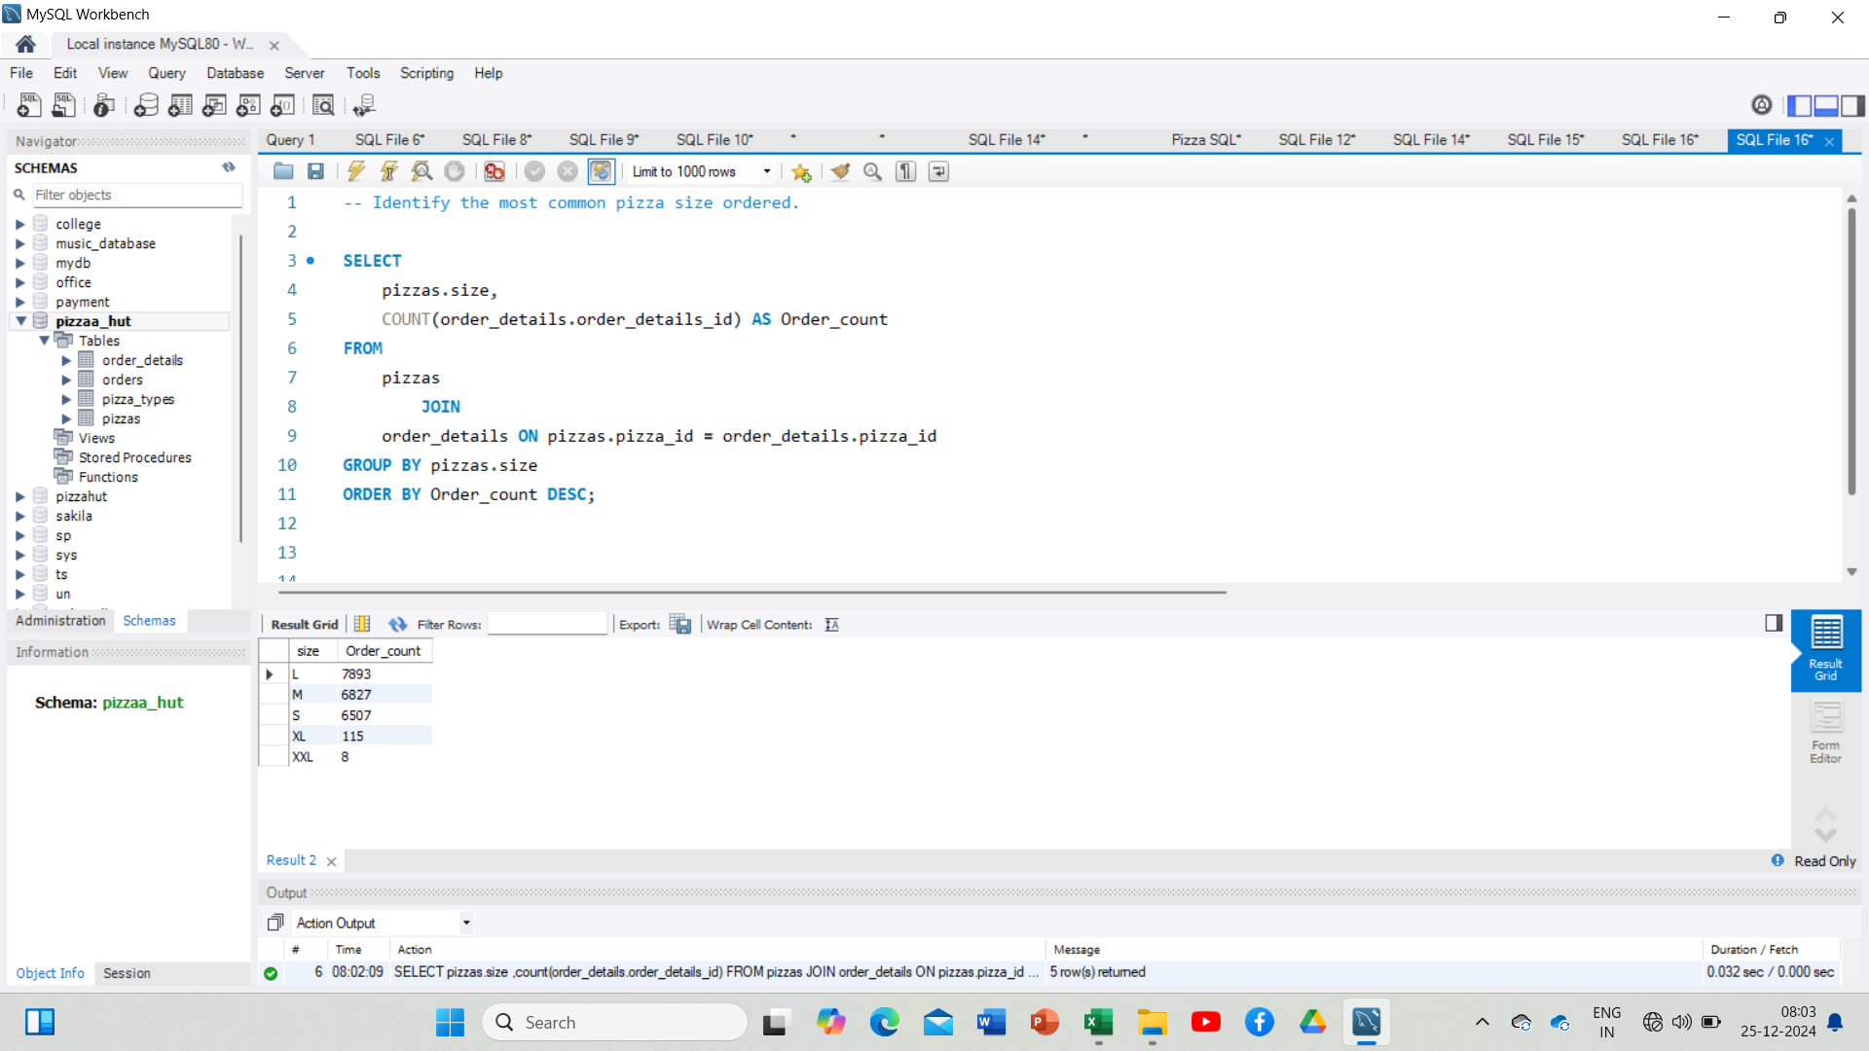
IDENTIFY THE MOST COMMON PIZZA
SIZE ORDERED.

Slide 6
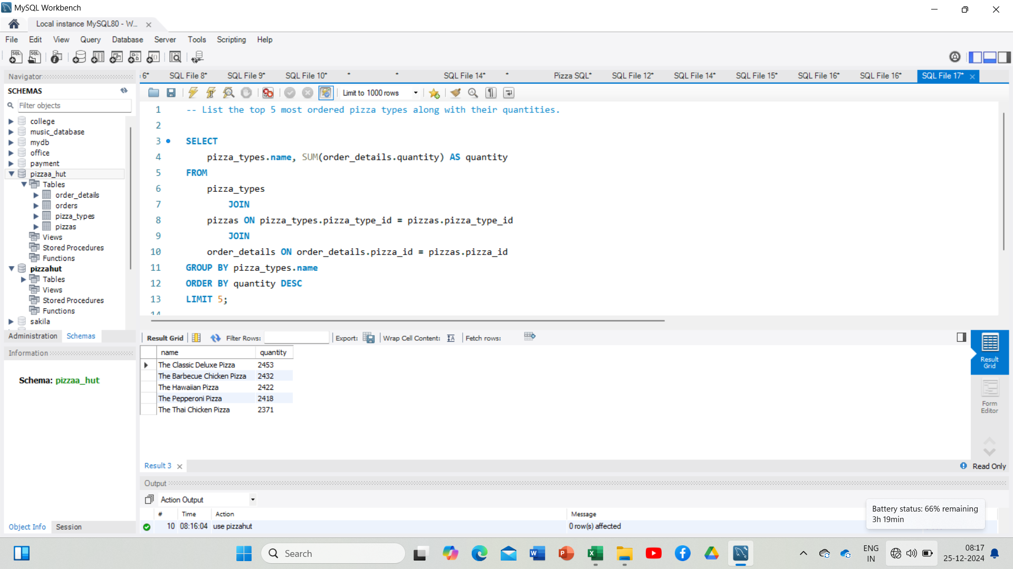
LIST THE TOP 5 MOST ORDERED PIZZA TYPES ALONG WITH THEIR QUANTITIES.

Slide 7
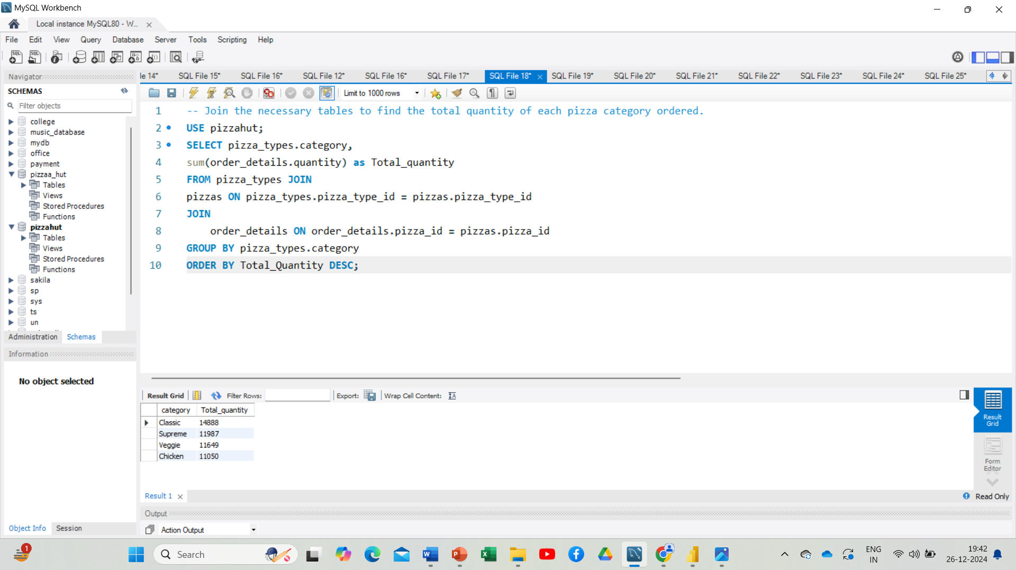
JOIN THE NECESSARY TABLES TO FIND THE TOTAL QUANTITY OF EACH PIZZA CATEGORY ORDERED.

Slide 8
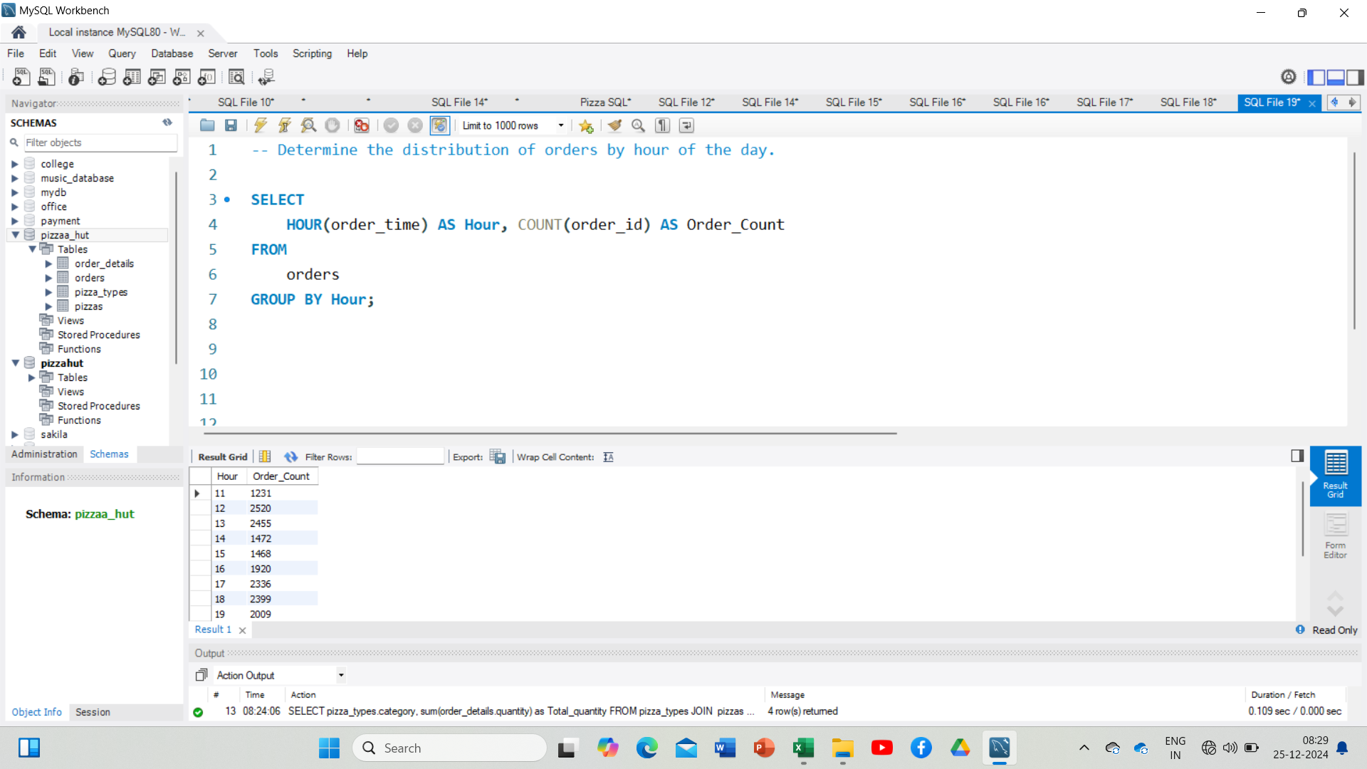
DETERMINE THE DISTRIBUTION OF ORDERS BY HOUR OF THE DAY.

Slide 9
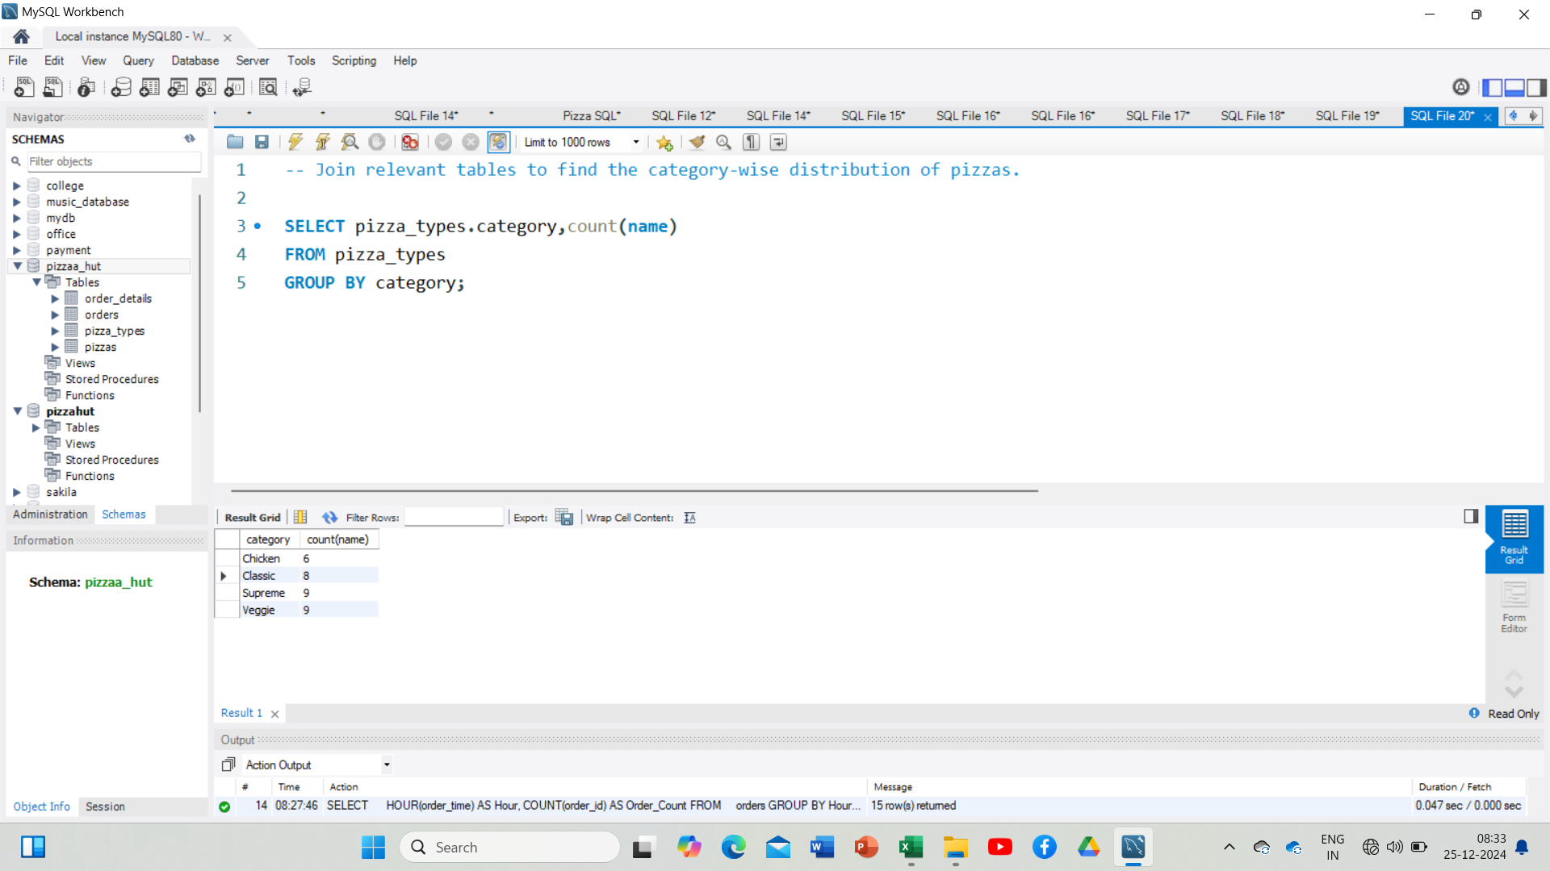
JOIN RELEVANT TABLES TO FIND THE CATEGORY-WISE DISTRIBUTION OF PIZZAS.

Slide 10
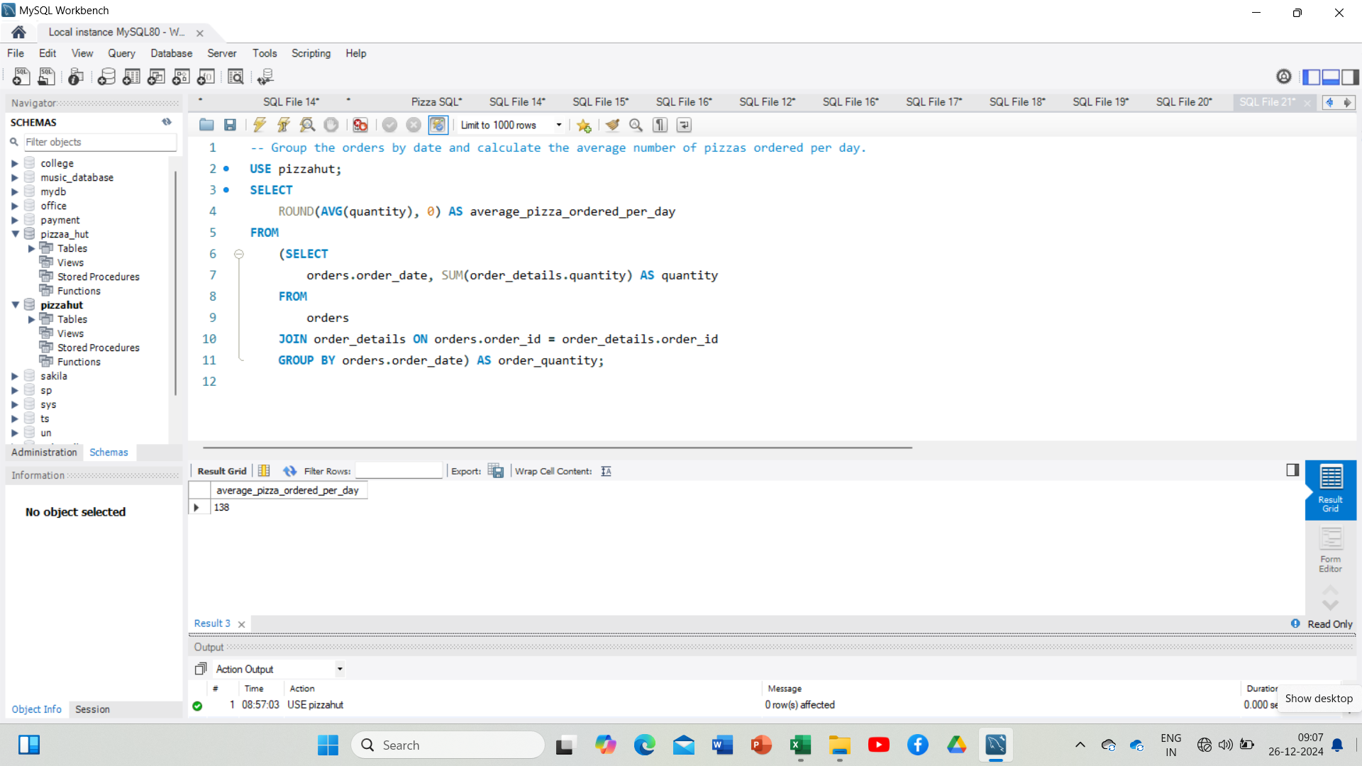
GROUP THE ORDERS BY DATE AND CALCULATE THE AVERAGE NUMBER OF PIZZAS ORDERED PER DAY.

Slide 11
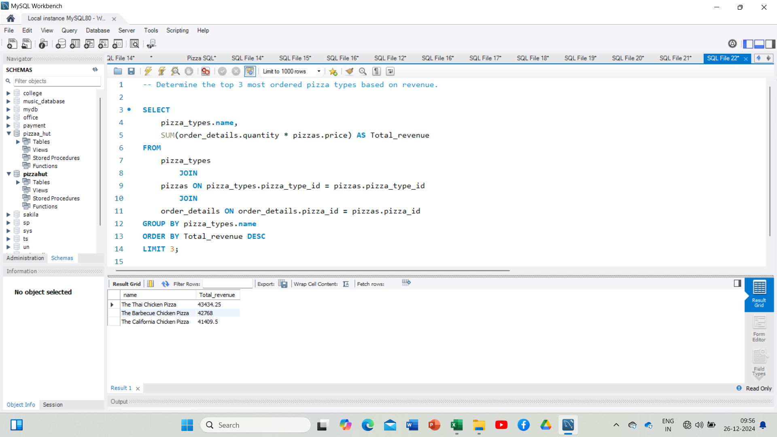
DETERMINE THE TOP 3 MOST ORDERED PIZZA TYPES BASED ON REVENUE.

Slide 12
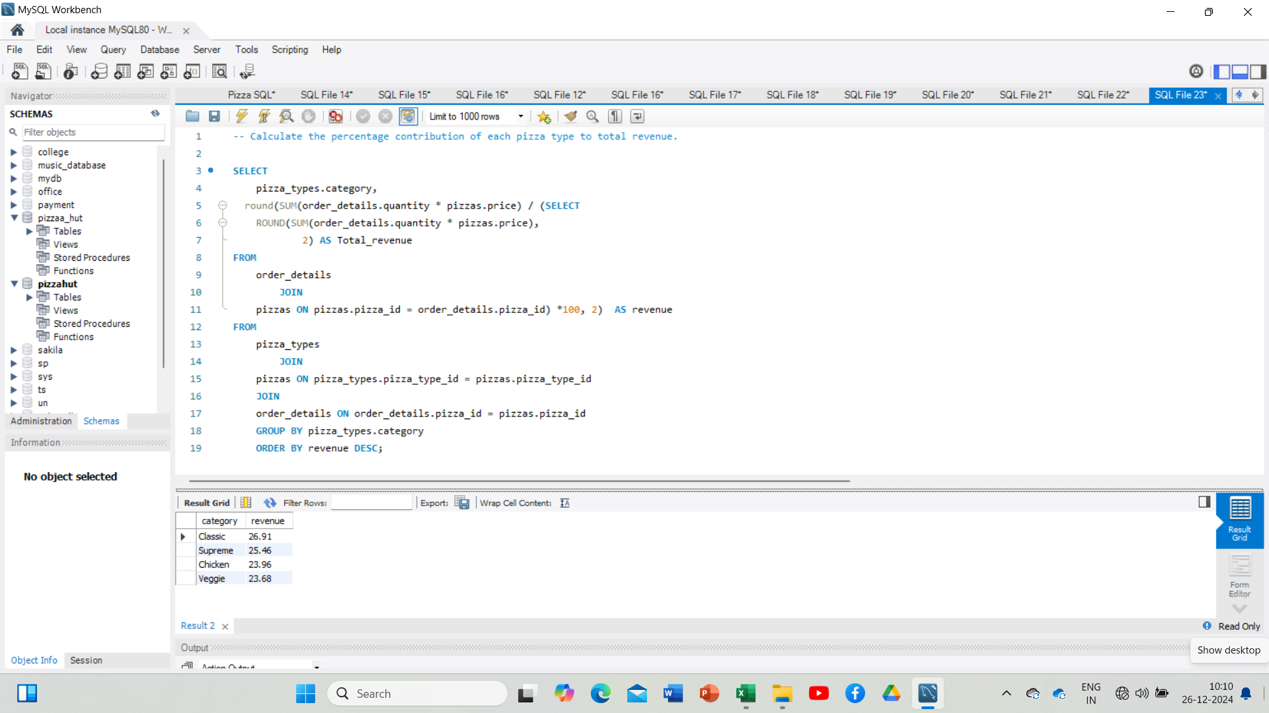
CALCULATE THE PERCENTAGE CONTRIBUTION OF EACH PIZZA TYPE TO TOTAL REVENUE.

Slide 13
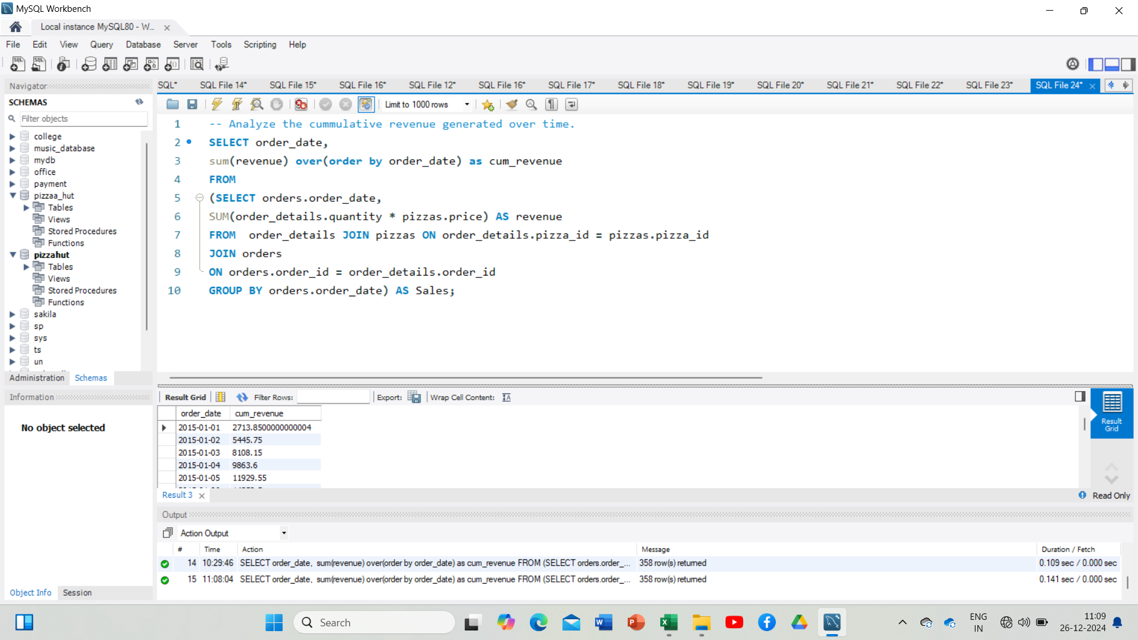
ANALYZE THE CUMULATIVE REVENUE GENERATED OVER TIME.

Slide 14
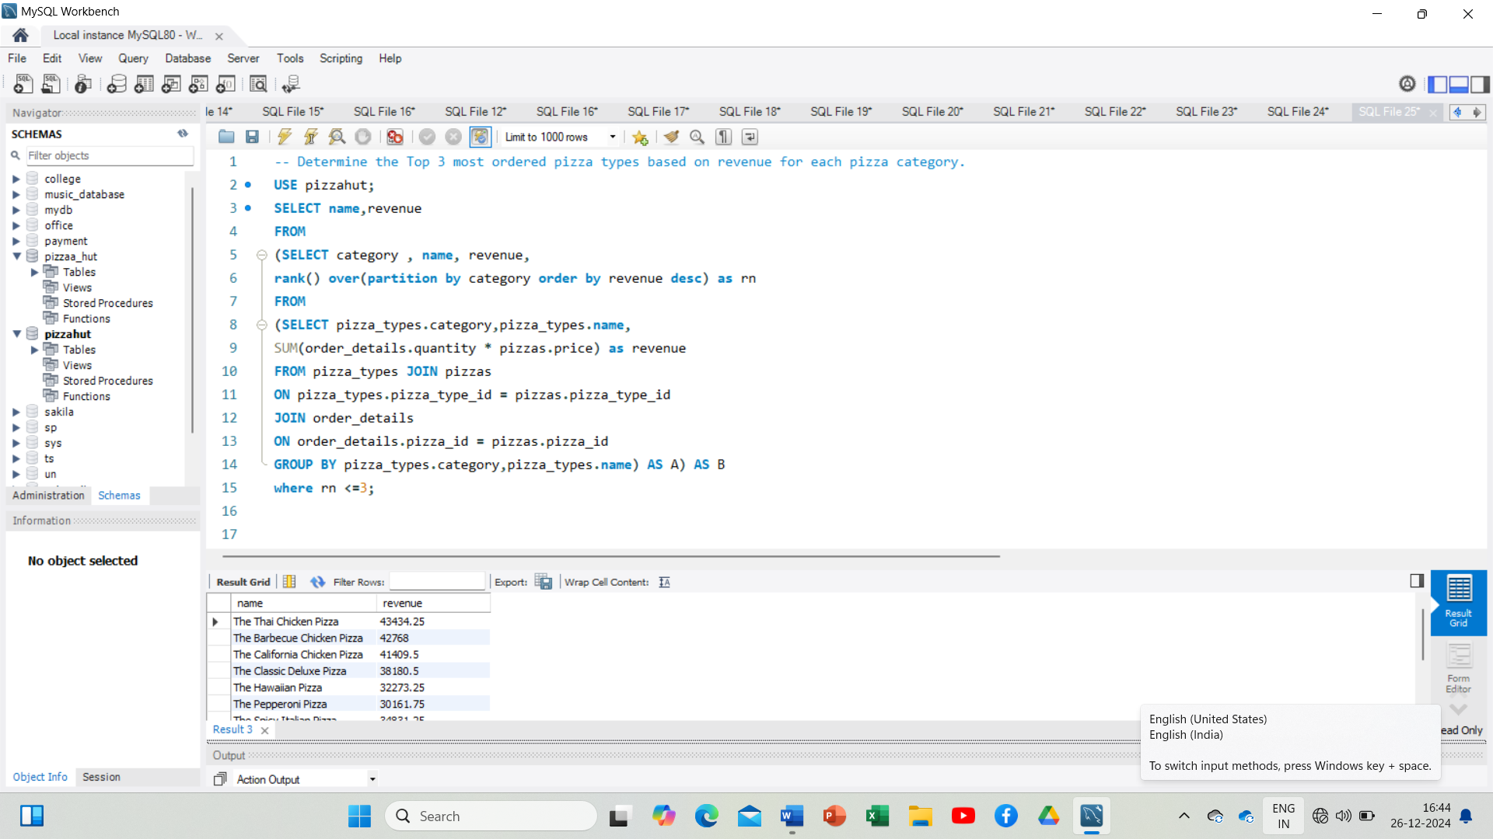
DETERMINE THE TOP 3 MOST ORDERED PIZZA TYPES BASED ON REVENUE FOR EACH PIZZA CATEGORY.

Slide 15
THANK YOU

